Slide 1




Supporting remote learning
at home

Slide 2
Top Tips
Remote learning at home is not always easy. Children are used to home being the place they don’t have to do school work. In the first lockdown, the expectation from home learning was different. This time round, the children are expected to access at least 3 hours a day of remote home learning and not all of that will be face to face teaching, most of that will be working independently at home on work set by school.
As parents who may be juggling your own work, have limited devices and/or have more than one child to help, here are some tips which might help set a routines, structure and expectation to your day to help your child know what is expected of them.
Everyone’s situations are different, so these strategies are aimed at supporting whatever situation you find you and your family in. At the end of the day, do your best, don’t compare yourselves with anyone else, ask for help if you need it!

Slide 3


Environment
Create the right environment for learning – devices not being used for learning away or off, quiet space if possible (could be kitchen, dining room, living room), away from as many distractions as possible. In some households a quiet space can be hard to find, do the best you can! Make sure all equipment needed is ready – laptop/iPad, paper, pencil etc. Make sure your child is comfortable – this will help them to be able to concentrate more on their learning tasks. In the classroom, they would have access to their water bottle, but snacks would wait until breaktime.
Create the right environment to help your child focus on their learning without distractions.

Slide 4




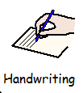
Timetable
In school, the children will be used to a VISUAL TIMETABLE which tells them what is coming up for the day. They are also used to doing the same thing at more or less the same time each day, but your circumstances at home may not allow for that. Set up a timetable which shows your child what they need to do each day, what order they will be doing it in. This can be varied depending on your own work commitments – if there is something they can complete more independently while you are working, great; if they need more support with something, find a time which works for you both. Ask them if they would like to help set up the timetable with you – are there tasks they would be happier to complete on their own or do first?
Build in a time for a break – they would have one at school, and you’ll both benefit from a rest from the work.
Create a visual timetable which shows your child what lessons they will be doing, and if needed how long each one will be.
Build in a break time.

Slide 5
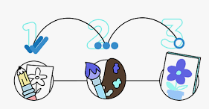
Break it down
Some of the tasks can seem a lot for your child to process all in one go, especially when they are trying to remember what’s been said in the TEAMS meeting too! If it helps to break the English/maths into 2 or 3 smaller sessions, it will help them (and you!) Three 20 minute burst of a task will produce more work from the child rather than 1 hour solid working.
If you have to take work calls/meetings as well as supporting at home, fit the lessons around what you have to do as well, or show your child when you will be available to help them/check their work.
Decide how to organise the lessons (perhaps split into smaller chunks of time). Use the visual timetable to show this.

Slide 6
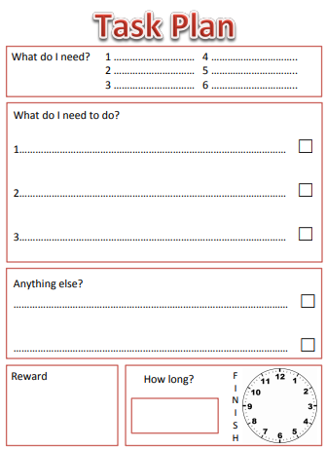
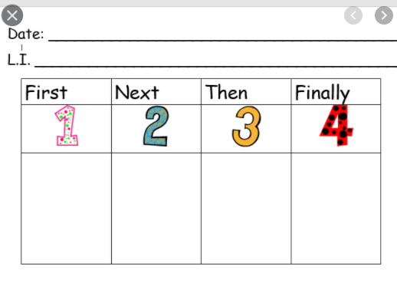
Task planner
The work set does not have to be done in one chunk, maths questions could be broken into smaller groups or 3 or 5 questions; English can be split into sections e.g. paragraphs or smaller groups of sentences. Decide how much you want your child to complete in each session – this can help your child see the work as manageable chunks rather than a mountain they can’t climb! This will also help with your child developing more independence too.
Decide how much your child has to complete in each session, to make sure the tasks are completed by the end of the day. Little and often will be more productive that one longer chunk of learning.

Slide 7

Refer back to previous lessons
Most learning is designed to build on previous lessons, so looking back at work already completed is a useful tool. It may be that a grammar skills or maths strategy has been used before and your child needs a reminder from their own work!
Look back at yesterday’s lessons to see if it will help.

Slide 8
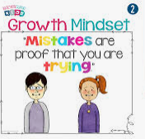
Praise making mistakes
Making mistakes is something lots of children find hard and they then don’t want parents to see they’ve made a mistake or get something wrong. Support them in seeing that making a mistake shows they have tried something new, they can learn from their mistake and it’s ok. Children may listen to their teachers more when it comes to correcting errors, so don’t push it at home so it creates arguments.
Turn making mistakes into something to be proud of rather than ashamed of.
Encourage your child to spot their own mistakes and correct them.

Slide 9

Praise effort rather than outcome
Encourage your child to work through their tasks by praising their efforts (e.g. working for 15 mins), rather than the amount of work they produce. Give them stickers/ticks on a chart which can result in a reward of some kind later on (time on technology, choosing a family activity at the end of the week, choice of location for a family walk, something that helps their mental wellbeing and doesn’t cost lots of money!
Agree a reward your child can earn daily/weekly.

Slide 10
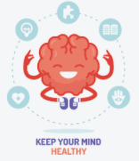
Look after mental wellbeing
Your child’s mental wellbeing is important, but so is yours! If work is becoming a major battle, pick the most important parts to focus on (English and Maths).
Build in some time each day for a break from work – let your child play with their toys, watch an episode of something on the TV or have a walk outside. This will help them refocus on their work when they return. Avoid using technology at this point – it can be hard to get them off again!
Build in time for mental wellbeing, breaks from work. Encourage some physical exercise (Go Noodle or Joe Wicks), try new relaxation techniques (Cosmic Yoga), read a book, eat a healthy snack.

Slide 11

Be flexible
If things are not working, or your child seems to have hit a brick wall, take a short brain break to see if it helps them refocus. Something active like running around the garden/up and down stairs, star jumps, touching toes, burpees, anything that will get the heart working harder and pump blood round the body faster will help stimulate the brain and help chase away sluggish feelings.
Be prepared to adjust timings and expectations if your child is struggling, try brain breaks for a couple of minutes to see if it helps bring the focus back.

Slide 12
Summary
Create the right environment to help your child focus on their learning without distractions.
Create a visual timetable which shows your child what lessons they will be doing, and if needed how long each one will be.
Build in a break time.
Decide how to organise the lessons (perhaps split into smaller chunks of time). Use the visual timetable to show this.
Decide how much your child has to complete in each session, to make sure the tasks are completed by the end of the day. Little and often will be more productive that one longer chunk of learning.
Look back at yesterday’s lessons to see if it will help.
Turn making mistakes into something to be proud of rather than ashamed of.
Encourage your child to spot their own mistakes and correct them.
Agree a reward your child can earn daily/weekly.
Build in time for mental wellbeing, breaks from work. Encourage some physical exercise (Go Noodle or Joe Wicks), try new relaxation techniques (Cosmic Yoga), read a book, eat a healthy snack.

